Slide 1


Tackling Salesforce Development
Non-Profit & Public Sector Industries
Achieve growth and improve operations while reducing operational costs.
Presented by:
Zena Thomas (Marketing Manager)
Talia Jackson (Account Executive)
Heidi Shaw (Anne Arundle Workforce Development Center)
Notes:
Speaker – ZT
Hello Everyone! Thanks for joining Top Shelf CRM’s webinar today, Tackling Salesforce Development in the Non-Profit Industry. My name is Zena Thomas, Marketing Manager here at Top Shelf CRM. From the Top Shelf CRM team, you’ll be hearing from Talia Jackson Account Executive and Yolanda Holt, Sales Manager. As a client testimonial, you’ll be hearing from Heidi Shaw, Vice President of Business and Industry Solutions with Anne Arundel Workforce Development Center.
During this webinar we will cover how to grow your NPO and improve operations and reduce costs using Salesforce Development.

Slide 2

About Us
At Top Shelf CRM, we live and breathe Salesforce.com so you don't have to. With our deep knowledge of development customization, we have helped hundreds of companies take full advantage of the powerful functionality of the SaaS platform.
We offer certified consultants to help your organization with staff augmentation, helping scale development and integration projects. Top Shelf CRM is headquartered in the greater Washington D.C. area and serves clients throughout the U.S. and Canada.
Industries served: Financial Services, Software, Education, Healthcare and Pharmaceuticals, Federal, and Non-Profit.
Notes:
Speaker - ZT
Just as a little brief background on Top Shelf CRM. For the past 9 years, we’ve helped hundreds of companies take full advantage of their Salesforce platform. We’re headquartered in the Washington D.C. area. We offer certified consultants to help your organizations with staff augmentation, helping scale development and integration projects.
We serve many verticals such as Financial Services, Software, Educations, Healthcare, Pharmaceuticals, Federal, and of course the Non-Profit space.
With that being said, I’m going to hand it over Talia Jackson will highlight our success growing and improving non-profits.

Slide 3

Our Success Growing and Improving Non-Profits
Growth: Growth with increased Salesforce user adoption.
Reporting: Increased efficiency of reporting.
Operational: Reduced operational expenses due to our as-needed support model.
Work: Ability to work quickly, scale and deliver projects.
Notes:
Speaker – TJ
Thank you, Zena!
Here at Top Shelf, we have worked with many non-profit organizations to optimize their investment in Salesforce. We help organizations grow by increasing user adoption, which increases return-on-investment with the CRM platform. We also create custom reports and refine existing reports to the specific needs of each client. Our as-needed support model does not have a minimum dollar amount, which means that teams can purchase 20 hours or 200 hours of consulting services. This helps organizations to maintain operational expenses and avoid any additional and unplanned expenses. We also have an extremely nimble development team, which allows us to scale and deliver projects in a fraction of the time that our competitors require. When necessary, we assign multiple developers to meet our client’s deadlines.
I’ll now share a small sampling of the challenges that we have helped non-profits to overcome.

Slide 4




NPO Challenges
Heavy Workload
Often, there are simply not enough hands to perform a task.
HR Management
A nonprofit business often involves volunteers and donors. A company has no financial or legal leverage to control them. Managing them is a challenge.
Event Non-Profit Management
Conducting a nonprofit event, securing the necessary funding, managing the logistics, promoting the event, and communicating with attendees is a lot of work.
Notes:
Speaker – TJ
We have seen, time after time, that our clients have a heavy workload with tight deadlines that can pop up unexpectedly. Often, the internal development team is managing large projects and is unable to tackle new, smaller projects.
Non-profits also tend to need assistance managing Activity tracking in Salesforce and donor management, which is where we come in. We have worked to help organizations create new workflows and tweak existing workflows to enhance the user experience.
Live and virtual events require much planning and execution, which also requires CRM and website integration. We have helped organizations create integrated event registration pages that capture vital attendee information and integrate it with Salesforce. We have also integrated customer surveys to provide a 360-degree view of the customer, all from within Salesforce.
I’ll now share some of the services that we offer to organizations.

Slide 5


OUR SERVICES
API Integration
Top Shelf CRM provides a highly scalable Salesforce integration that enables you to connect and streamline operations. Easily access, replicate and integrate Salesforce data with any data source including adjacent enterprise systems, databases, and custom applications.
Salesforce Implementation
Whether you’re just getting started, migrating from a legacy system, or restructuring an existing setup, we’ll guide your team from initial planning to go-live date providing best practices that conform to industry standards.
Marketing Services
Marketo
We have extensive experience customizing Marketo to suit the needs of individual clients. We can help your organization harness the power of the platform by customizing it to the email needs of your Marketing department.
Marketing Cloud
Whether your organization is rolling out Marketing Cloud or is already using Marketing Cloud and would like to automate additional email journeys, we can help. We provide various development services that assist in maximizing ROI from the Marketing Cloud.
Web Development
Top Shelf CRM creates the website of your dreams. Top Shelf builds websites and provides development support for your team.
Notes:
Speaker – TJ
Our company was founded to help customers implement Salesforce and take the frustration out of setup and rollout. We also work with existing Salesforce customers that would like to enhance an existing implementation that wasn’t rolled out optimally. Many times, we have seen that in a few short weeks, we can really help customers maximize their usage of Salesforce and truly get the results they’re looking for from their CRM investment. But, based on client requests, we also offer API integrations, web development and marketing services. In addition to the services on the screen, we also have additional service offerings to assist and feel free to contact me directly to learn more.
I’ll now turn it over to Zena Thomas, who will cover our client testimonial, Anne Arundel Workforce Development Center.

Slide 6

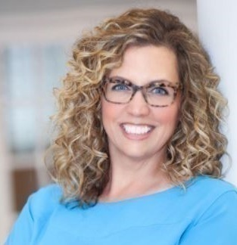
Anne Arundel Workforce Development Center
Our Success Story
Heidi Shaw
Vice Presentient of Business and Industry Solutions
Notes:
ZT- Announce Heidi Shaw
Thanks, Talia!
Let’s highlight a success story of ours with Anne Arundel Workforce Development Center. AAWDC is a 501c3 nonprofit corporation that provides high quality workforce development services to businesses and citizens of Anne Arundel County.
In the past, they were using another software consulting firm to solve their development needs. Due to unexpected risingdevelopment costs, they began evaluating other trustworthy, cost-effective solutions to their growing development needs.
We’ve had the pleasure so far of working with Heidi Shaw VP Business and Industry Solutions on 120 hours of custom Salesforce and Development work.

Slide 7

AAWDC Case Study
Anne Arundel Workforce Development Center is a 501c3 nonprofit corporation that provides innovative, high quality workforce development services to Anne Arundel County businesses and citizens.
In the past, Anne Arundel Workforce Development Center was using another software consulting firm to solve their development needs. Due to rising unexpected development costs, AAWDC began evaluating other trustworthy, cost-effective solutions to their growing development needs.
Top Shelf CRM has performed 120 hours of custom Salesforce and Mailchimp.
Our Work
Provided thorough discovery phase.
Transparent pricing.
Top-notch communication.
Project care and consideration.
Relationship software consulting that puts the client first.
Project accuracy unmatched.
Results
The project customized out-of-box Salesforce functionality to meet the business needs of AAWDC. This allowed AAWDC to begin fully utilizing Salesforce and automate business processes.
Notes:
ZT speaks:
Heidi, on behalf of Top Shelf CRM, it’s always a pleasure working with you. I’d love to ask you accouple questions regarding your experience working with us here at Top Shelf. With that being said…
1. Why did you choose to use Top Shelf?
2. What separates Top Shelf from other consultants you’ve used?
3. How was Top Shelf able to help you accomplish your strategic business goals?
4. Would you use Top Shelf again?
Thanks for the feedback, Heidi! Always a pleasure working with you!
To highlight other success stories from our other clients…

Slide 8
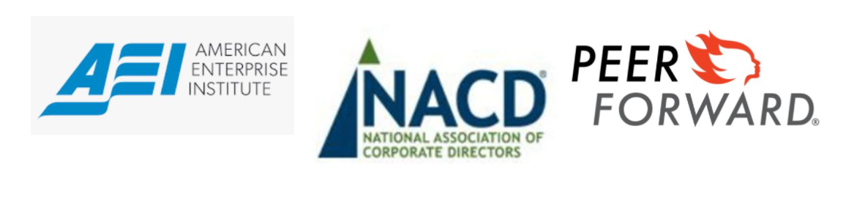




OUR CLIENTS
NON-PROFIT
ADDITIONAL CLIENTS
Notes:
Zena speaks:
Here’s a little about the NPO clients we serve.
For AEI, we provided several hundred hours of custom development of their Marketo platform.
NACD: NACD we provided over 2,000 hours of Salesforce, Marketo and API integration development work.
Peer Forward - We provided several hundred hours of development work to integrate web forms with Salesforce and enable data tracking across multiple platforms.
In addition to the NPO clients, we also serve the Financial Services, Software, Educations, Healthcare, Pharmaceuticals, Federal and more verticals as well.
Unite Here Health - We developed over 400 hours of custom API development to integrate a legacy database with Salesforce and enable a 360-degree view of customer data.
Adobe - We developed custom code to help Adobe scale their sales teams by tracking accuracy and performance of each individual sales rep.
Stenberg College - We provided custom service to enable efficient tracking of sales rep productivity.
Click to next slide Zee.

Slide 9

THANK YOU!
Notes:
ZT speaks.
This concludes today’s webinar. I want to thank everyone for joining. You all will be receiving a recording of this webinar so you can re-watch it at different time or share it with another team member.
Feel free to book your first consultation with us in regards to your next Salesforce Development Project. This month, we are running a June promotion.

Slide 10
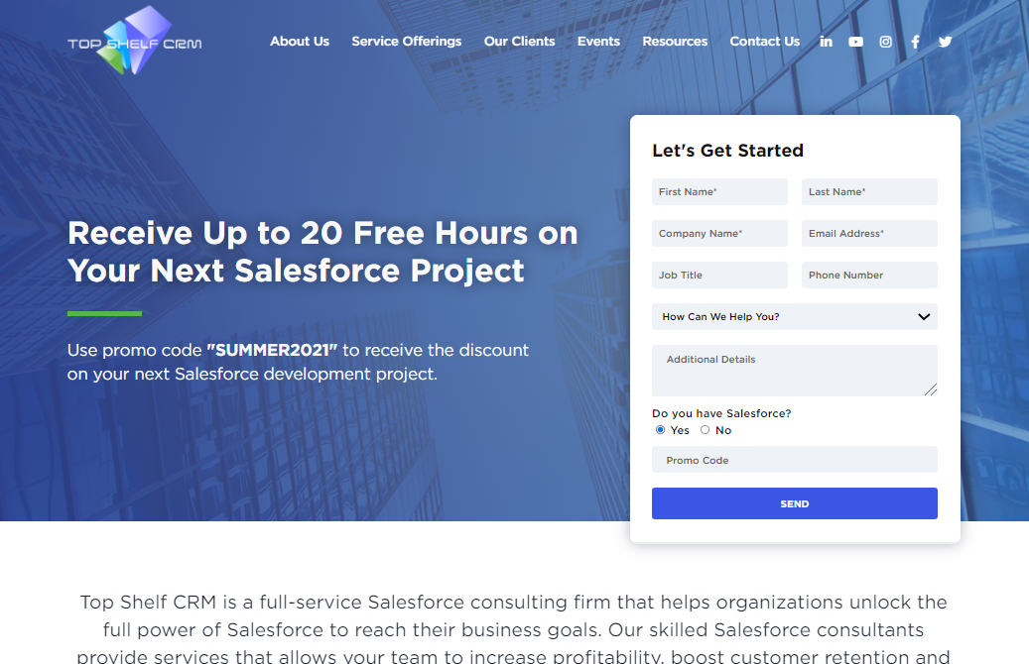
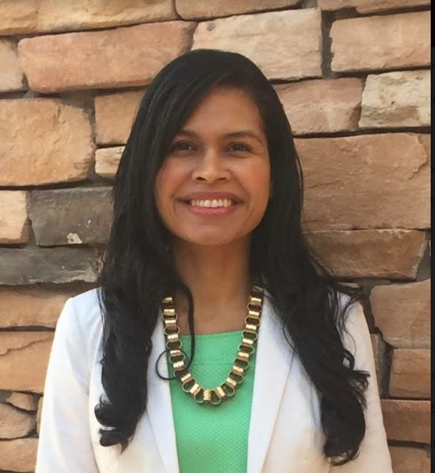
Jump start your NPO’s growth and start saving today!
Receive up to 20 free hours on your next Salesforce development project
Talia Jackson
Account Executive
tjackson@topshelfcrm.com
(877) 738-2869 x 703
Book a consultation on our website and use code “SUMMER2021”.
Book a consultation with a Top Shelf CRM team member and mention code “SUMMER2021”.
Notes:
ZT Announces promo.
To help jump start your NPO’s growth, we’re offering up to 20 free hours on your next Salesforce Development project.
Here’s how it works. There are 2 options.
Visit our website (www.TopShelfCRM.com), book consultation and use the code “JUNE2021” to receive your discount.
Or Book a consultation directly with our Top Shelf CRM team member -Talia Jackson. Her contact information is listed below.
I would like to take some time to open a Q & A for any questions that you all have.
We look forward to working with you all in the future! Have a great day!

